Slide 1
Neural networks: forward and backward passing

Slide 2
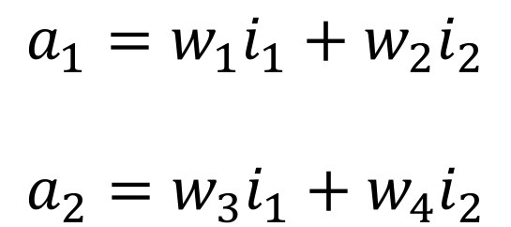
Forward Pass (linear)
w1 w5
i1
a1
o1
$$a_{1}=w_{1}i_{1}+w_{2}i_{2}$$
$$a_{2}=w_{3}i_{1}+w_{4}i_{2}$$
w3 w7
w2 w6
i2
a2
o2
w4 w8
Let’s do this in Excel

Slide 3
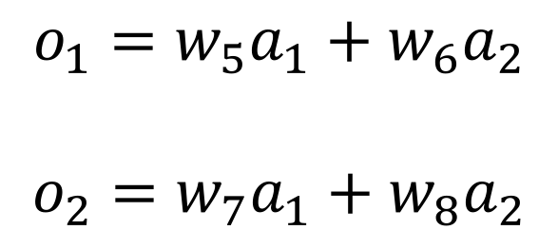
Forward Pass (linear)
w1 w5
i1
a1
o1
$$o_{1}=w_{5}a_{1}+w_{6}a_{2}$$
$$o_{2}=w_{7}a_{1}+w_{8}a_{2}$$
w3 w7
w2 w6
i2
a2
o2
w4 w8
Let’s do this in Excel

Slide 4
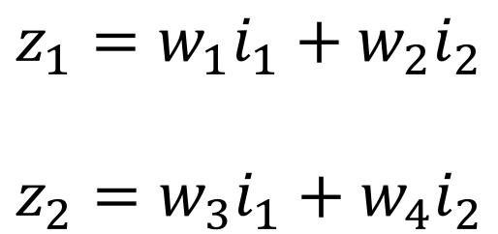
Forward Pass (non-linear)
w1 w5
i1
z1 a1
z3 o1
$$z_{1}=w_{1}i_{1}+w_{2}i_{2}$$
$$z_{2}=w_{3}i_{1}+w_{4}i_{2}$$
w3 w7
w2 w6
i2
z2 a2
z4 o2
w4 w8
Let’s do this in Excel

Slide 5
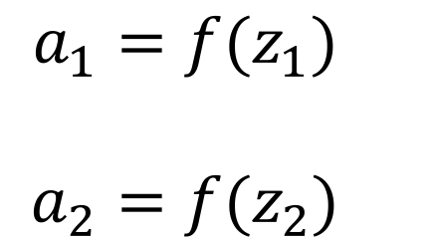
Forward Pass (non-linear)
w1 w5
i1
z1 a1
z3 o1
$$a_{1}={f(z_{1}) }_{}$$
$$a_{2}={f(z_{2}) }_{}$$
w3 w7
w2 w6
i2
z2 a2
z4 o2
w4 w8
Let’s do this in Excel

Slide 6
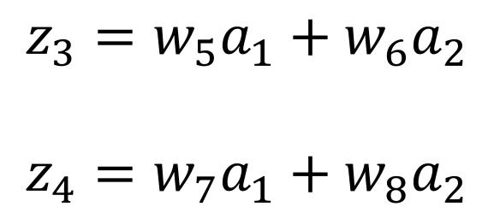
Forward Pass (non-linear)
w1 w5
i1
z1 a1
z3 o1
$$z_{3}=w_{5}a_{1}+w_{6}a_{2}$$
$$z_{4}=w_{7}a_{1}+w_{8}a_{2}$$
w3 w7
w2 w6
i2
z2 a2
z4 o2
w4 w8
Let’s do this in Excel

Slide 7
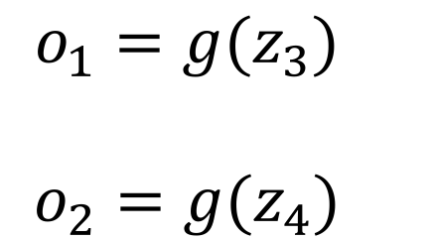
Forward Pass (non-linear)
w1 w5
i1
z1 a1
z3 o1
$$o_{1}={g(z_{3}) }_{}$$
$$o_{2}={g(z_{4}) }_{}$$
w3 w7
w2 w6
i2
z2 a2
z4 o2
w4 w8
Let’s do this in Excel. Then add a non-linear activation

Slide 8
Forward Pass
We have now completed
a full forward pass. (with/without non-linearity)
The next step to to compare
the prediction of the network
to the true values for given input.
w1 w5
i1
z1 a1
z3 o1
w2 w6
w3 w7
i2
z2 a2
z4 o2
w4 w8

Slide 9
Backward Pass
We need a way to adjust the weights so that the output of the network is closer to the correct output.
We can use back propagation to do this.
We compute the errors obtained at the end of the network and “back propagate” those errors through the network one layer at a time to adjust the weights.

Slide 10

Before proceeding, let’s understand the term “error”.
$$E=e_{1}+e_{2}$$
$$e_{1}={{\left(o_{1}−t_{1}\right)}^{2}}_{}$$
$$e_{2}={{\left(o_{2}−t_{2}\right)}^{2}}_{}$$
w1 w5
i1
z1 a1
z3 o1
w2 w6
w3 w7
i2
z2 a2
z4 o2
w4 w8

Slide 11
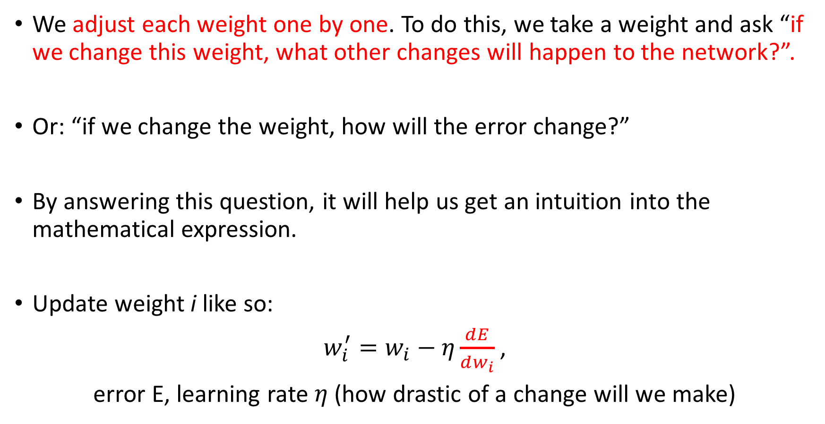
We adjust each weight one by one. To do this, we take a weight and ask “if we change this weight, what other changes will happen to the network?”.
Or: “if we change the weight, how will the error change?”
By answering this question, it will help us get an intuition into the mathematical expression.
Update weight i like so:
$w_{i}^{′}=w_{i}−η\frac{ⅆE}{dw_{i}}$ ,
error E, learning rate $η$ (how drastic of a change will we make)

Slide 12

This “$\frac{ⅆE}{dw_{i}}”$can be read as: what change in network predictive error will we get if we change weight i.
All we need to do is find out what computations are affected once we change weight i.
Changing w5 means that z3 will change, consequently a3 will change, and so will E. w5 -> z3 -> o1 -> E
w1 w5
i1
z1 a1
z3 o1
w2 w6
w3 w7
i2
z2 a2
z4 o2
w4 w8

Slide 13
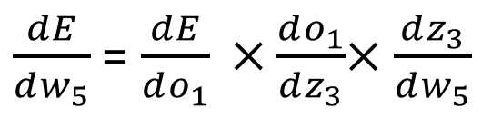
w1 w5
The ripple effect is as follows: w5 -> z3 -> o1 -> E
Analytically, this translates to:
i1
z1 a1
z3 o1
w2 w6
w3 w7
$\frac{ⅆE}{dw_{5}}$ = $\frac{ⅆE}{do_{1}} ×\frac{ⅆo_{1}}{dz_{3}}$× $\frac{ⅆz_{3}}{dw_{5}}$
i2
z2 a2
z4 o2
w4 w8
In a computer package, these derivatives will be computed automatically for you. In fact, this entire process is done for you.

Slide 14
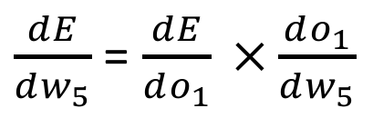
Let’s simplify the problem by removing the non-linear function in layer 2 and 3 and simply have a linear function.
(previously had o1(z3) and o2(z4) where o1 and o2 were non-linear functions) Let’s update w5
w1 w5
i1
a1
o1
The ripple effect is as follows: w5 -> o1 -> E
Analytically, this translates to:
w2 w6
w3 w7
$\frac{ⅆE}{dw_{5}}$ = $\frac{ⅆE}{do_{1}} ×\frac{ⅆo_{1}}{dw_{5}}$
i2
a2
o2
w4 w8

Slide 15
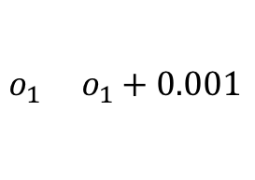



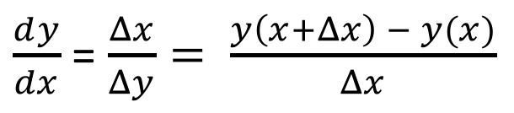
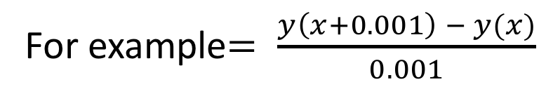
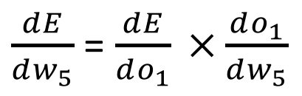
The ripple effect is as follows: w5 -> o1 -> E
Numerically, this translates to:
What does $\frac{ⅆE}{do_{1}}$ mean?
$\frac{ⅆE}{dw_{5}}$ = $\frac{ⅆE}{do_{1}} ×\frac{ⅆo_{1}}{dw_{5}}$
$$E(o_{1}+0.001)$$
Let’s recap derivatives
$$E(o_{1})$$
$\frac{ⅆy}{dx}$ = $\frac{Δx}{Δy}= \frac{y\left(x+Δx\right) − y(x)}{Δx}$
For example$= \frac{y\left(x+0.001\right) − y(x)}{0.001}$
$$o_{1} o_{1}+0.001$$

Slide 16
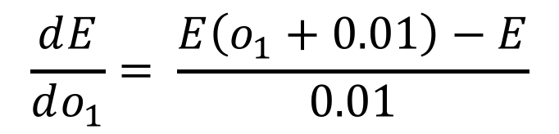
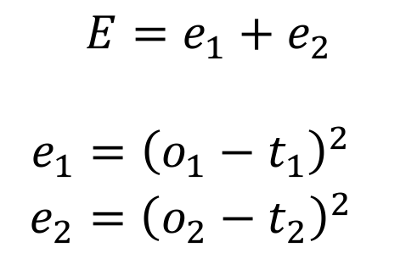


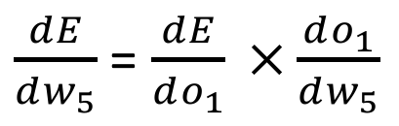
$\frac{ⅆE}{dw_{5}}$ = $\frac{ⅆE}{do_{1}} ×\frac{ⅆo_{1}}{dw_{5}}$
We want to compute
$$\frac{ⅆE}{do_{1}}= \frac{E\left(o_{1}+0.01\right)−E}{0.01}$$
Let’s solve the first term
$$E=e_{1}+e_{2}$$
$$e_{1}={{\left(o_{1}−t_{1}\right)}^{2}}_{}$$
$$e_{2}={{\left(o_{2}−t_{2}\right)}^{2}}_{}$$
We already know what E is
$$E\left(o_{1}+0.01\right)−E=$$
$${\left(o_{1}+0.01−t_{1}\right)}^{2}+e_{2}−E$$
Let’s do this step in Excel

Slide 17
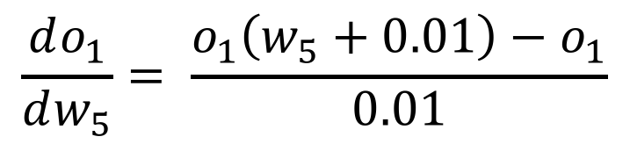
$\frac{ⅆE}{dw_{5}}$ = $\frac{ⅆE}{do_{1}} ×\frac{ⅆo_{1}}{dw_{5}}$
We want to compute
$$\frac{ⅆo_{1}}{dw_{5}}= \frac{o_{1}\left(w_{5}+0.01\right)−o_{1}}{0.01}$$
Let’s solve the second term
Let’s do this step in Excel

Slide 18
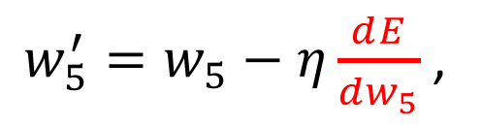
$\frac{ⅆE}{dw_{5}}$ = $\frac{ⅆE}{do_{1}} ×\frac{ⅆo_{1}}{dw_{5}}$
and can now do this in Excel
We want to compute
The final step is to update the weight
$w_{5}^{′}=w_{5}−η\frac{ⅆE}{dw_{5}}$ ,
Let’s do this final step in Excel.
Effects on learning rate?
Another example?

Slide 20
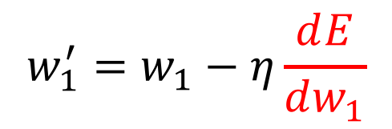
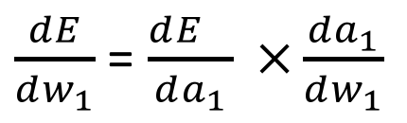
Finally, here is how to update the weights in the earlier layers in the network.
Like before: Let’s update w1
$$w_{1}^{′}=w_{1}−η\frac{ⅆE}{dw_{1}}$$
The ripple effect is as follows: w1 -> a1 -> E
w1 w5
i1
a1
o1
w2 w6
$\frac{ⅆE}{dw_{1}}$ = $\frac{ⅆE_{}}{da_{1}} ×\frac{ⅆa_{1}}{dw_{1}}$
w3 w7
i2
a2
o2
w4 w8

Slide 21
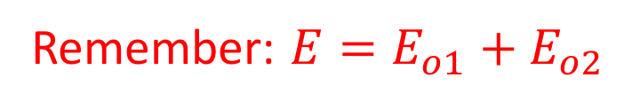
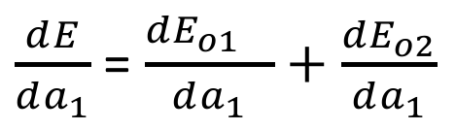



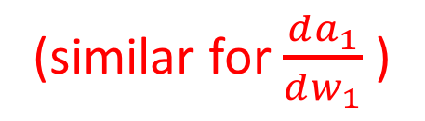

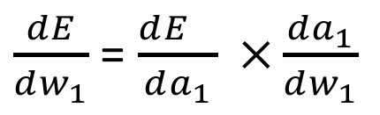
$\frac{ⅆE}{dw_{1}}$ = $\frac{ⅆE_{}}{da_{1}} ×\frac{ⅆa_{1}}{dw_{1}}$
The ripple effect is as follows: w1 -> a1 -> E
Remember: $E=E_{o1}+E_{o2}$
w5
a1
o1
$\frac{ⅆE}{da_{1}}$ = $\frac{ⅆ{E_{o1}}_{}}{da_{1}}+\frac{ⅆE_{o2}}{da_{1}}$
$$E_{o1}$$
w7
$$\frac{ⅆ{E_{o1}}_{}}{do_{1}}×\frac{ⅆo_{1}}{da_{1}}$$
Remember: $o_{1}=w_{5}a_{1}+w_{7}a_{2}$
a2
$$\frac{ⅆo_{1}}{da_{1}}=w_{5}$$
(similar for $\frac{ⅆa_{1}}{dw_{1}}$ )
Let’s do these steps in Excel

Slide 22
Keras is a platform that allows you to easily create neural network models. It is possible to interface between Keras and R.
You define a sequential model.
Define a neural network architecture (number of layers, type of layer etc…).
Define a loss function (so that the network knows if it’s doing a good job)
Finally, train the model, validate and test on new data.

Slide 23
Keras can use a CPU or GPU (faster execution).
To use Keras in R, import this: library(keras)
Model is initialised as follows: model <- keras_model_sequential()
Example model in R:
model %>%
layer_dense(units = 256, activation = 'relu', input_shape = c(784)) %>%
layer_dense(units = 10, activation = 'softmax')
Examples here: https://github.com/rstudio/keras/tree/master/vignettes/examples
parameters

